Slide 1
Chronic Kidney Disease (CKD)
Liz Leen

Slide 2
Patient
Enez Joaquin
24 y/o Pima Indian
Diagnosed with T2DM at age 13
Has not been compliant with prescribed
treatment
Progressive decompensation of
kidney function over past 7 years
Diagnosed with Stage 3 CKD 2 years ago
Has developed acute symptoms over past 2 weeks
GFR is 28 mL/min

Slide 3
Symptoms
Anorexia
N/V
4 kg weight gain in past 2 weeks
Edema
In extremities, face, and eyes
Shortness of breath
Anuria
Malaise
Muscle cramping
Notes:
Anuria – absence of urine

Slide 4
CKD
Kidney damage or a decrease in kidney function that lasts over three month
Kidney function measured by the glomerular filtration rate (GFR)
A GFR less than 60 cc/min/1.73 m2 for more than 3 months indicates CKD
5 stages of disease; GFR indicates which stage a patient is in

Slide 5
Diagnostic Measures
Stage 1: GFR > 90 mL/min/1.73 m²
Normal or elevated GFR
Stage 2: GFR 60-89 (mild)
Stage 3: GFR 30-59 (moderate)
Stage 4: GFR 15-29 (severe)
Stage 5: < 15 (kidney failure)

Slide 6
Mrs. Joaquin’s GFR
28 mL/min
Indicates stage 4 of CKD
Kidney function is severely diminished
Preparing and evaluating for kidney replacement therapy

Slide 7
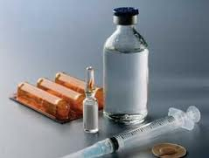
Etiology
Most common causes of CKD are diabetes and high blood pressure
Other causes:
Autoimmune diseases
Infection-related diseases
Sclerotic diseases
Urinary tract infections
Cancer

Slide 8
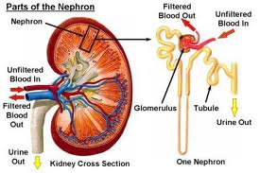
Diabetic Kidney Disease
Changes in nephrons due to high levels of blood glucose from uncontrolled DM
Starts with the thickening of glomeruli and ending in destruction
High levels of sugar in
blood can also damage
blood vessels that bring
oxygen and nutrients to kidneys

Slide 9
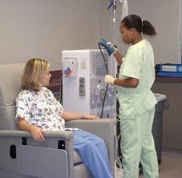
Medical/Surgical Treatment
Goal: treat underlying pathophysiology to delay progression of disease
Progression of disease is highly individualized
Dialysis
Hemodialysis – blood is filtered
outside the body, cleaned, and
then returned to the body
Notes:
Patient usually spends 3-4 hours per treatment 3 times a week at a dialysis center

Slide 10
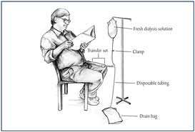
Medical/Surgical Treatment
Dialysis
Peritoneal dialysis – peritoneal cavity is used and a dialysate in introduced through a peritoneal catheter
Can be performed in any clean, well-lit location
Offers more freedom and flexibility for patient
Notes:
A solution is introduced into the peritoneal cavity waste products and extra fluid pass form the blood through the peritoneal membrane and into the solution, where it is then removed. So the peritoneal membrane acts like a filter

Slide 11
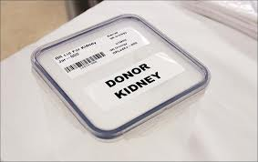
Medical/Surgical Treatment
Kidney Transplant
Matches must be immunologically compatible
After transplant patients put on immunosuppressives
Corticosteroids
Cyclosporine
Tacrolimus
Mycophenolate mofetil
Sirolimus

Slide 12
Medical Nutrition Treatment
Nutrition Therapy:
35 kcal/kg
1.2 g protein/kg
Protein restriction help preserve kidney function
Protein losses during dialysis
2 g potassium
1 g phosphorus
2 g sodium
1,000 mL fluid + urine output
Notes:
Kcal: Adequate energy intake is important in order to prevent protein being utilized for energy. The National Kidney Foundation has found that energy intake of 35 kcal/kg/day for patients younger than 60 provides adequate calories to prevent excessive protein loss through catabolism and malnutrition
Protein restriction helps kidneys work less which delays progression of disease by controlling uremia
During hemodialysis the patient loses some protein, so it is important to prevent protein energy malnutrition
Potassium restriction necessary due to inability to remove potassium – can cause abnormal heart rhythms
Phosphorus restrictions are also due to the inability to remove excess. Excess can lead to hyperphosphatemia which can lead to bone problems, low blood calcium, calcification or hardening of tissues and other serious health problems.
Sodium restriction is important in controlling fluid intake, fluid retention, and high blood pressure
Fluid restriction is important because people with CKD don’t urinate often, which causes fluid retention, increased blood pressure, weight gain, and congestive heart failure

Slide 13
Mrs. Joaquin’s energy needs
BMI based on edema-free adjusted body weight of 140 (63.6 kg) lbs is 27
Energy needs: 2,226 kcal/day
Protein requirement: 76.32 g/day
Should obtain 50% of protein from sources that have high biological value

Slide 14
Nutrition Assessment
Self-reported usual diet high in potassium, phosphorus, sodium, and energy
Recent anorexia, nausea, and vomiting has lead to a decrease intake
Elevated serum phosphorus, potassium, creatinine, and low GFR
Stage 4 CKD

Slide 15
Nutrition Diagnosis
PES statements
Altered nutrition-related laboratory values including elevated serum potassium as related to dietary choices high in potassium as evidenced by serum potassium of 5.8 mEq/L and self-reported potassium intake of 4.3g
Excessive sodium intake as related to fluid retention and usual intake of foods high in sodium as evidenced by reported intake of 3.3 g of sodium

Slide 16
Nutrition Intervention
Goal 1
Lower serum potassium to normal range
Limit dietary potassium to 2 g/day
Educate on implications on health if excess potassium is consumed
Educate on foods both high and low in potassium
Create a sample meal plan to help keep dietary goals
Track potassium dietary intake

Slide 17
Nutrition Intervention
Goal 2
Reduce fluid retention gains to acceptable range per dialysis treatment
Limit dietary sodium to 2 g/day
Educate on implications on health of consuming excess sodium and fluid intake
Educate on foods both high and low in sodium and in fluids
Create a sample meal plan to help keep dietary goals
Track sodium dietary intake

Slide 18
Tips to Help Control Fluid Intake
Limit high-salt foods
Drink from small glasses and cups
Use sour candy or sugar –free gum to moisten mouth
Add lemon juice to water or ice
Freeze grapes and eat throughout the day
Counts as a serving of fruit too!!!
Swish very cold water or low alcohol mouthwash in mouth
Don’t swallow
Notes:
Lemon juice- sour taste will help to quench thirst

Slide 19
Nutrition Monitor/Evaluation
Monitor self-reported adherence to dietary requirements
Monitor self-monitoring ability
Recording foods and beverages
Monitor mineral intake
Include potassium and sodium
Monitor oral fluid intake
Monitor electrolyte and renal profile
Include potassium and sodium

Slide 20
Prognosis
There is no cure for chronic kidney disease
Untreated, it usually worsens to end-stage renal disease
Lifelong treatment may control the symptoms of CKD

