Slide 1
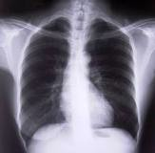
COPD with Respiratory Failure

Slide 2
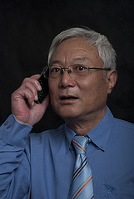
Patient Background
Daishi Hayato
Age 65
Male
Asian American
Retired
Wife and 4 adult children
Father had lung cancer
Primary Diagnosis:
Acute respiratory distress, COPD, peripheral vascular disease with intermittent claudication

Slide 3
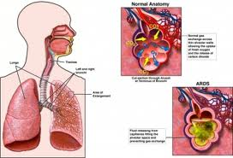
Etiology
Acute Respiratory Distress (ARDS)
Occurs when fluid builds up in the alveoli in the lungs
More fluid in the lungs means less oxygen can reach your bloodstream, depriving organs of the oxygen they need to function
Primary symptom: Severe shortness of breath

Slide 4
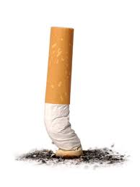
Etiology
COPD – Chronic Obstructive Pulmonary Disease
A progressive disease in which airflow is limited or restricted
Most times associated with emphysema (destruction of alveoli/lungs over time), bronchitis (inflammation of the lining of the bronchial tubes), or in rare cases, a genetic protein deficiency
Primary risk factor: Smoking
Mr. Hayato was diagnosed with emphysema more than
10 years ago and has a long-standing history of COPD
secondary to chronic tobacco use of 2 packs per
day for 50 years

Slide 5
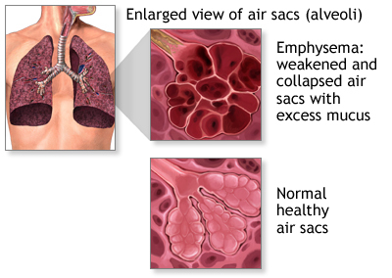
Etiology

Slide 6
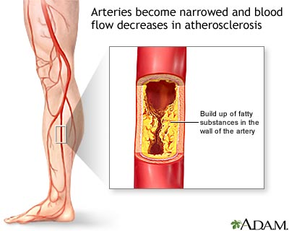
Etiology
Peripheral vascular disease with intermittent claudication
Peripheral vascular disease occurs when the arteries in the extremities become clogged with a fatty substance called plaque
This plaque build up causes atherosclerosis in the arteries, obstructing blood flow
The blocked arteries cause
claudication or “crampy
leg” when exercising, with pain
that comes and goes

Slide 7
Nutrition History
Appetite: Fair but decreasing
Largest meal: Breakfast
Highest Weight: 135 lbs
Current Weight: 122 lbs
Height: 5’4”
No previous nutrition therapy
BMI: 21.7 kg/m²
%UBW: 90%
IBW: 126 lbs
%IBW: 97%
Unintended Weight Loss
Estimated REE needs: 1500 – 1600 kcals
80 - 83 grams protein

Slide 8
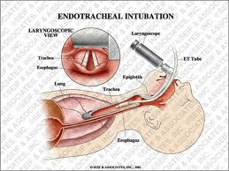
At the Hospital
Chest tube inserted into left thorax with drainage under suction
Endotracheal intubation
Placed on ventilation
15 breaths/min with an FiO2 of 100%
Positive end-expiratory pressure of 6
Tidal volume of 700 mL
Daily chest radiographs (X-ray) and ABGs each A.M.

Slide 9
Treatment Plan
ABG, pulse oximetry, CBC, chemistry panel, UA (urinalysis)
Chest X-ray, ECG, Proventil
IVF D5 ½ NS at TKO
Spirogram post nebulizer tx
NPO
Increased calorie needs (10-15%)

Slide 10
Tube Feedings
Initiated on Day 2 of admission
Isosource @ 25 cc/hr continuously over 24 hours
Receiving 720 calories and 25.8 grams of protein per day
High gastric residuals led to discontinued use of enteral feeding and initiation of peripheral parenteral nutrition (PPN)
PPN @ 100 cc/hr
ProcalAmine – 3% glycerin, 3% amino acids
Receiving 312 calories and 69.6 grams of protein per day
Regular IV at D5 ½ NS at TKO was discontinued

Slide 11
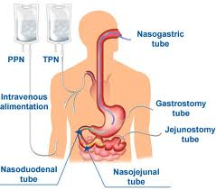
Tube Feedings
Day 4: Enteral feeds restarted @ 25 cc/hr, increased to 50 cc/hr after 12 hours
ProcalAmine also continued @ 100 cc/hr
Total Energy Intake: 1,712 calories – excessive
Respiratory status became worse on Day 5; ProcalAmine was discontinued
Enteral feedings continued until Day 8
Patient weaned from ventilator Day 8
Discharged on Day 11

Slide 12
Lab Values: Arterial Blood Gases (ABGs)

Slide 13
Medical Nutrition Therapy: Nutrition Diagnosis
Excessive intake from enteral/parenteral nutrition related to excessive energy intake as evidenced by elevated CO₂ levels and an increased RQ

Slide 14
Medical Nutrition Therapy: Intervention
Initiate EN or PN (ND-2.1)
Modify rate, concentration, composition, or schedule (ND-2.2)
Discontinue EN or PN (ND-2.3)
Priority modification (E-1.2)
Goal setting (C-2.2)
Social support (C-2.5)

Slide 15
Medical Nutrition Therapy: Monitor & Evaluation
Monitor enteral feeding tolerance (residuals) & peripheral parenteral nutrition
Monitor lab values
Arterial blood gases (ABGs)
pH
Blood counts
RQ
Monitor weight gain/loss

Slide 16
Medical Nutrition Therapy: D/C Treatment for Mr. Hayato
Prevent further weight loss by eating sufficient calories
Consume a diet rich in antioxidants → fruits, vegetables, and fish helps lower incidence of COPD
Decrease consumption of red meats, refined grains, desserts and french fries
Increased consumption of vitamins C, A, and E and beta-carotene to help cope with oxidative damage undergone during exacerbation which depletes concentrations of these vitamins
Monitor phosphate levels for adequacy; crucial for pulmonary function because it is essential for synthesis of ATP

Slide 17
Medical Nutrition Therapy: D/C Treatment for Mr. Hayato
Assess calcium and vitamin D intake and ensure adequacy to help prevent osteoporosis
Advise patient to consume good sources of protein and calories, as well as sources that are nutrient dense
Rest before meals to avoid fatigue
Eat smaller, more frequent meals to alleviate feelings of fullness and bloating
Advise exercise, as capable
Strength/resistance training may help improve skeletal muscle function; skeletal muscle dysfunction is often an indicator of COPD in its advanced stages

Slide 18
Prognosis
There is no cure for COPD
Ways to Improve Overall Quality of Life:
Smoking Cessation
Dietary changes
Taking medications as directed
Routine medical care and as needed

Slide 19
Question #1
Why are high gastric residuals in tube-fed patients dangerous?

Slide 20
Question #2
What primary macronutrient makes it more difficult to wean a patient from a ventilator?
Why?

Slide 21
Question #3
What two factors indicated that Mr. Hayato was receiving excess nutrition from his parenteral and enteral feeds?

Slide 22
References
http://www.mayoclinic.com/health/ards/DS00944
http://www.emphysemafoundation.org/pulmonary-disease/57-copd.html
http://www.rxlist.com/procalamine-side-effects-drug-center.htm
http://www.todaysdietitian.com/newarchives/060210p8.shtml
http://www.in.gov/fssa/files/aspiration_prevention_8.pdf.
Medeiros, D., Wildman, R. (2009). “Advanced human nutrition.” Sudbury, MA: Joans and Bartlett Learning, LLC.
Nelms, M., Sucher, K. (2011). “Nutrition therapy and pathophysiology.” Belmont, CA: Wadsworth Cengage Learning.
http://www.umm.edu/patiented/articlesintermittent_claudication_other_symptoms_of_peripheral_artery_disease_000102
http://dailymed.nlm.nih.gov/dailymed/drugInfo.cfm?id=66097
http://www.drugs.com/pro/procalamine.html

